Slide 1




Aqua
Pulse
An Autonomous Submarine:
Facilitating Marine Life Sustenance

Slide 2



Marine life
Marine life refers to all the plants, animals, algae, fungi, bacteria, and other organisms that live in the saline (saltwater) habitats of oceans, seas, or the brackish water of coastal estuaries, wetlands, and lagoons.
The oceans provide 50% of the world’s oxygen supply and they provide essential ecosystem services that allow our planet to function in a healthy way.
Ocean currents govern our weather systems, and if they were to be interrupted, the extreme weather consequences would be drastic. The oceans can only provide these services by maintaining delicately balanced ecosystems, made up of food chains and biological systems. Human activity risks the shutdown of essential ecosystem services that we rely on to survive.

Slide 3

The problem
Humans continue to pollute the oceans, despite the huge risks to marine life and to ourselves. Marine pollution comes in many forms such as plastic pollution, acidification and oil spills.
The largest risk posed to marine life is the fishing industry. Vast commercial fleets trawling the oceans has been common practice for many years and sadly shows no signs of slowing.
Fish farms pollute waters with the chemicals needed to treat diseases caused by the appalling conditions, excess feed and concentrated fish waste. This pollution causes algal booms, resulting in the deaths of wild fish, too.
Plastic pollution kills 100 million marine life every year, this could cause endangerment of species which can directly affect the entire ecosystem of the world, including humans.

Slide 4
Existing Solution
Autonomous river-cleaning devices: These already exist but take up a lot of space, energy and money for its operation and isn’t easily deploy-able to a water body.
Pollution monitoring systems: They typically contain a fixed sensor, which monitors a particular area. This means hundreds of these sensors need to be deployed in-order to scan even a small water body.
Water treatment centers: Majority of the water sources in India aren’t treated, thus leaving them polluted and toxic. Although such machines do exist, it’s not possible to deploy them in all places.
We have identified few major drawbacks of the existing solutions.
They are not mobile and are often confined to a small area
They are too expensive for the average person
They are often too big to monitor small water bodies

Slide 5
Our Solution : Aqua Pulse
An autonomous (self-operated) submarine that monitors pollution levels, aquatic life, their movements and their behavior.
Our submarine model is small enough to navigate and monitor small water bodies
Because it is mobile, it is not confined to a particular area. This flexibility allows it to be deployed across various locations, adapting quickly to changing needs and environments without being restricted by geographic boundaries.
Since is a small submarine, it is very inexpensive to build, making it accessible to fisherfolk. This fixes the major problems that other existing solutions already have.

Slide 6
Autonomous
Our submarine is completely autonomous, meaning that it requires no human input to be operated.
The submarine does this by making use of machine learning models. The various sensors gives information to the AI Model, and based on that information, the submarine may make decisions, such as to observe a specific population of fish, go to another area or give warnings to the human operator.
This ensures that the submarine can operate with zero human input, but at the same time, it provides, us, humans with valuable information.

Slide 7
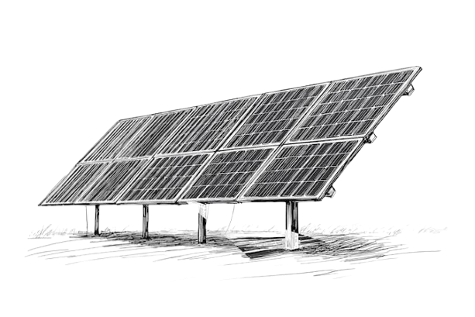
Energy Source: Solar
The submarine gets its energy from solar, meaning no batteries have to be replaced. Once it is deployed, it is completely self-operated. When the submarine is not occupied by any task (as decided by the AI Model), it will decide to rise to the surface during day times, giving it time to charge itself.
Ensuring that the submarine remains online for 24/7, with no interruptions. In case of days with no sunlight, it will still operate on the built-in batteries until it gets sunlight.
PS: Similar to how Mars rovers get their energy

Slide 8
Thank You

